Slide 2




Hunting for bugs, catching dragons
Nicolas Joly - @n_joly
MSRC Vuln rabilities and Mitigati ns Team
This presentation is for informational purposes only. MICROSOFT MAKES NO WARRANTIES, EXPRESS OR IMPLIED, IN THIS SUMMARY.

Slide 3

Attacking Outlook with s

Slide 4
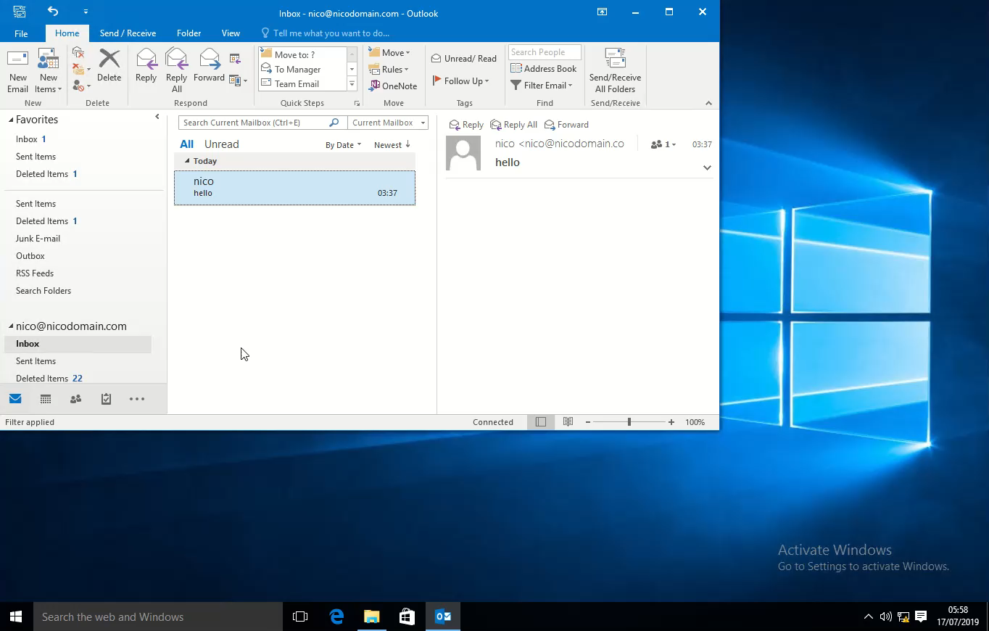
Demo noclick CVE-2017-8506

Slide 5
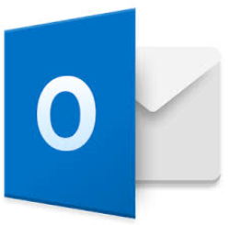
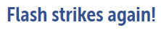
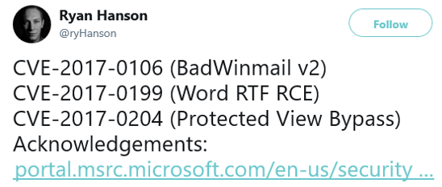
Outlook exploits?
Uncommon, not seen in the wild for a while
I Love You / Love Letter, early 2000
Badwinmail reported by Haifei Li in late 2015:
Showed how to load Flash in Outlook
Leveraged a known Flash vulnerability to prove RCE
Ryan Hanson’s amazing research submitted in late 2016:
Issues with the RTF format
COMs and Monikers
Some cool Outlook features
Abusing Word features
Embedding an EPS font (CVE-2015-2545)?
news.softpedia.com

Slide 6
Quick summary of the attack surface
Email protocols
SMTP
POP3/IMAP
Exchange Active Sync
Exchange Web Services
Autodiscover
…
Spoofing
Certs issues
Name spoofing
S/MIME
DRMs
…
Email parsing
MIME parsing
HTML / RTF
Pictures (GDI or Office stacks)
Fonts
OLE Objects
Calendars, iCals, vCards, contacts
Attachments
TNEF, MAPI properties
…
Misc
Macros
SensePost’s Ruler (rules, scripts, homepage)
…

Slide 7
What this talk covers
Email protocols
SMTP
POP3/IMAP
Exchange Active Sync
Exchange Web Services
Autodiscover
…
Spoofing
Certs issues
Name spoofing
S/MIME
DRMs
…
Email parsing
MIME parsing
HTML / RTF
Pictures (GDI or Office stacks)
Fonts
OLE Objects
Calendars, iCals, vCards, contacts
Attachments
TNEF, MAPI properties
…
Misc
Macros
SensePost’s Ruler (rules, scripts, homepage)
…

Slide 8

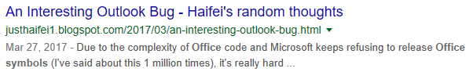

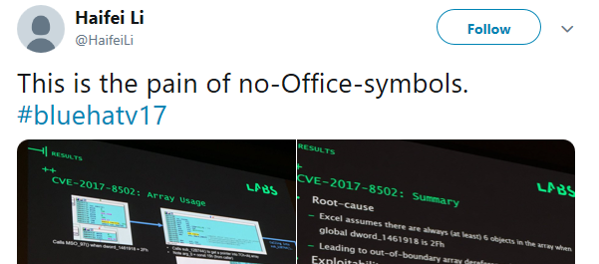
Why this talk?
Exploits for Outlook exist but we only occasionally receive reports of dragons outstanding issues
Why aren’t researchers reporting to us?
Lack of public research, blog posts describing issues?
Lack of interest in the area?
Symbols unavailable for Office?
How can we help our finders?
Let’s talk about our own research!
Note:
The vulnerabilities discussed in the following slides have all been resolved

Slide 9
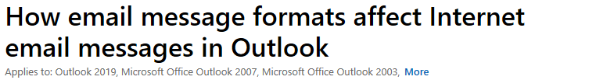
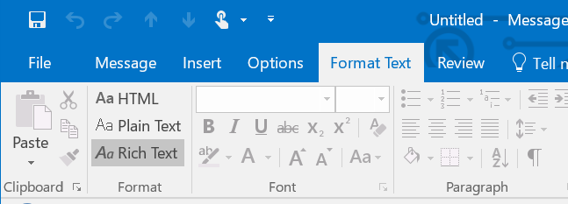
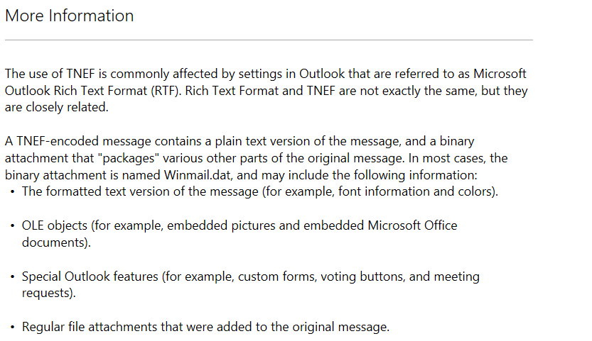
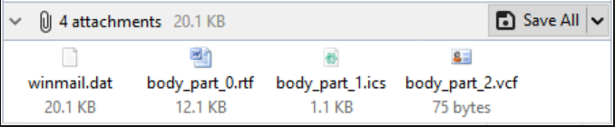
Where to start? RichText emails?
https://support.microsoft.com/sq-al/help/290809

Slide 10
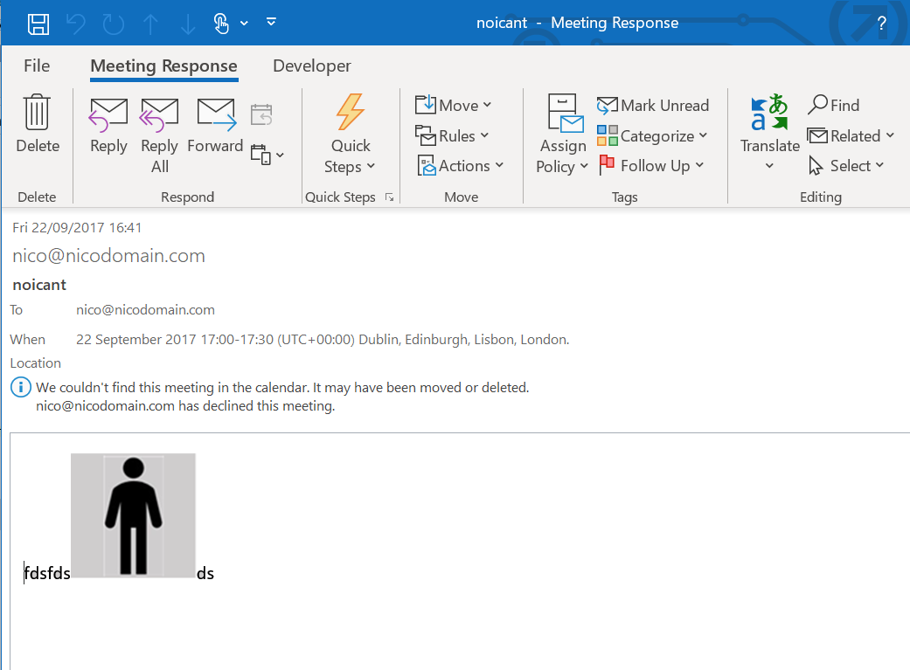
What’s a TNEF email?

Slide 11
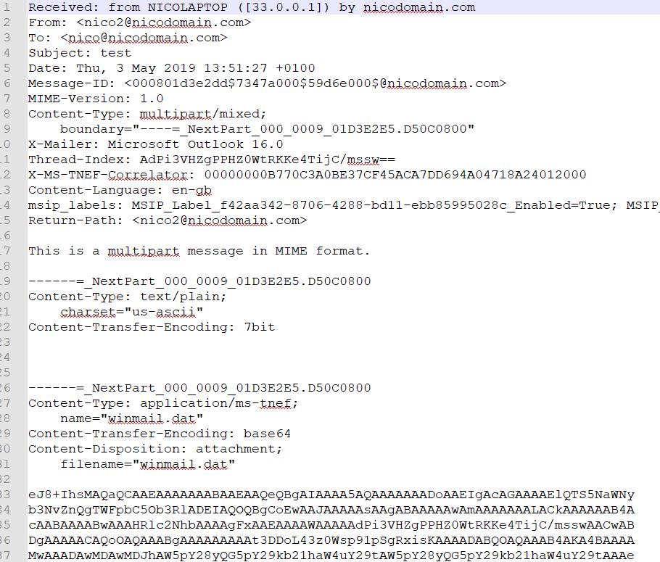
What’s a TNEF email?

Slide 12
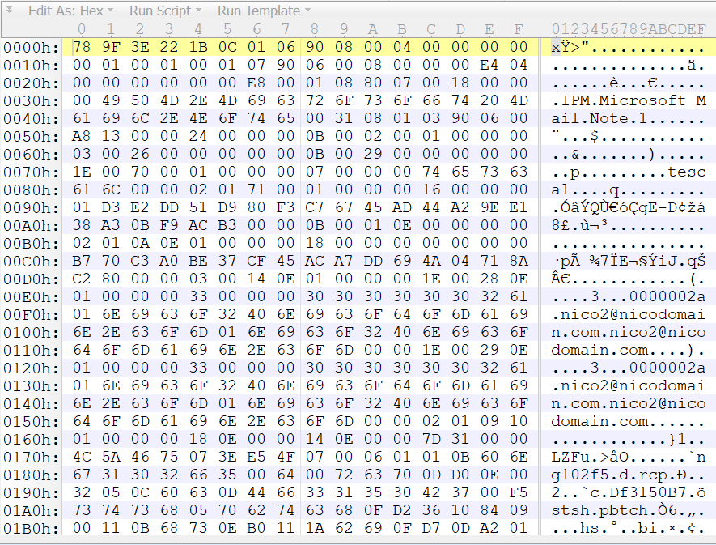
What’s a TNEF email?
What’s this?

Slide 13
TNEF specifications
[MS-OXTNEF]
Sequence of objects, containers and properties
Easy to parse
Developed an 010 template
Might release in the future

Slide 14
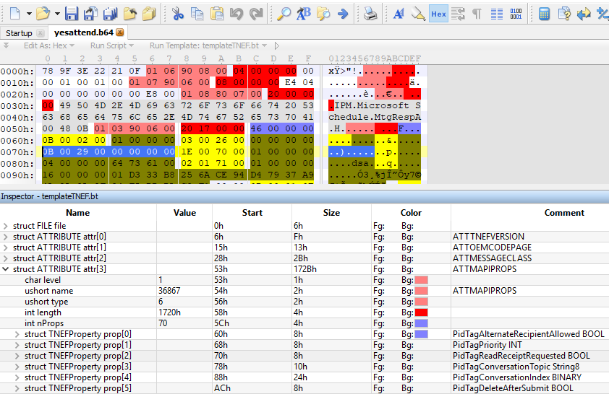
TNEF specifications
[MS-OXTNEF]
Sequence of objects, containers and properties
Easy to parse
Developed an 010 template
Might release in the future

Slide 15
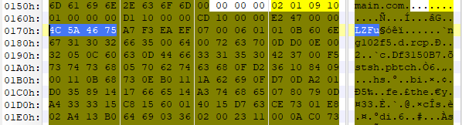
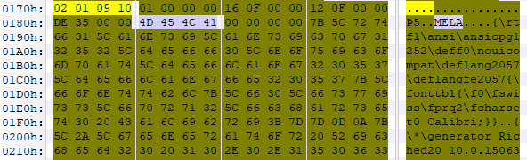
TNEF or RTF - Rich Text Format?
One special property PR_RTF_COMPRESSED = 0x10090102
Various encodings
LZFu? Compressed RTF, default
MELA? Plain RTF, easy to change
Bit flipping this field will generally result in a broken email
Use instead the Outlook Interop Library and send TNEF emails programmatically

Slide 16
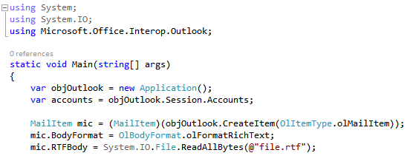
TNEF or RTF - Rich Text Format?
One special property PR_RTF_COMPRESSED = 0x10090102
Various encodings
LZFu? Compressed RTF, default
MELA? Plain RTF, easy to change
Bit flipping this field will generally result in a broken email
Use instead the Outlook Interop Library and send TNEF emails programmatically

Slide 17
Examples of issues affecting Outlook
CVE-2017-0106? Introduced by the \template keyword:
Remotely (and locally) loads files (http, smb)
Also loads embedded objects, like Flash
Dramatically extends the attack surface by allowing all the Word supported formats (docx, doc…)
CVE-2018-0794
Cyclic reference in the template names leading to Use After Free
a.rtf => b.rtf => \not found\a.rtf
Resolution?
\template no longer supported in Outlook

Slide 18
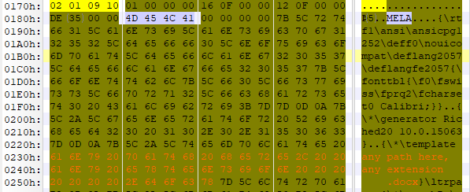
Examples of issues affecting Outlook
CVE-2017-0106? Introduced by the \template keyword:
Remotely (and locally) loads files (http, smb)
Also loads embedded objects, like Flash
Dramatically extends the attack surface by allowing all the Word supported formats (docx, doc…)
CVE-2018-0794
Cyclic reference in the template names leading to Use After Free
a.rtf => b.rtf => \not found\a.rtf
Resolution?
\template no longer supported in Outlook

Slide 19
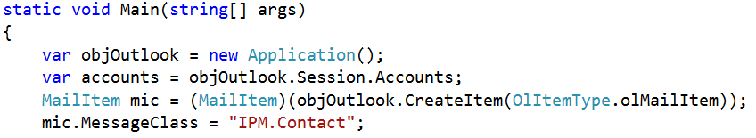
Outlook Interop, how to build an email
Provides an API to build your own emails
Example, create a MailItem, change the MessageClass to IPM.Contact and send it
See the contact form appear in the preview pane

Slide 20
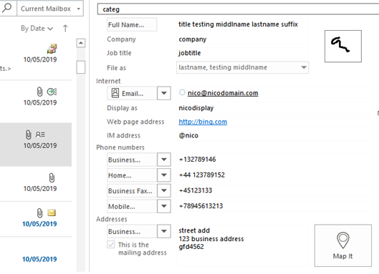
Outlook Interop, how to build an email
Provides an API to build your own emails
Example, create a MailItem, change the MessageClass to IPM.Contact and send it
See the contact form appear in the preview pane

Slide 21
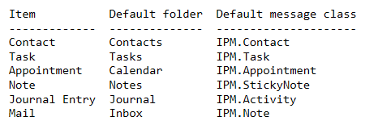
Outlook Interop, how to build an email
Provides an API to build your own emails
Example, create a MailItem, change the MessageClass to IPM.Contact and send it
See the contact form appear in the preview pane
Each class has its own properties/features

Slide 22
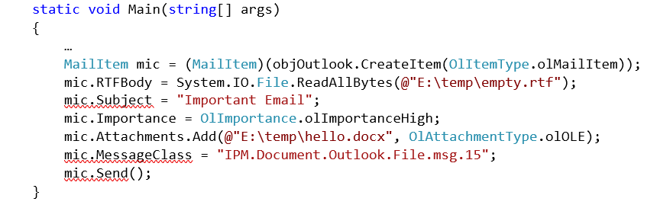
Other class names and bugs related
Some examples listed here https://docs.microsoft.com/en-us/office/vba/outlook/concepts/forms/item-types-and-message-classes
Create a mail item and change its class to IPM.Remote
Used to trigger a null pointer in the preview pane
Reported by Etienne Stalmans and fixed as vNext
IPM.Document.*, aka “freedocs”
CVE-2017-0204, Office documents open without Protected Mode, Ryan Hanson
CVE-2017-8571, Office documents open without user interaction

Slide 23
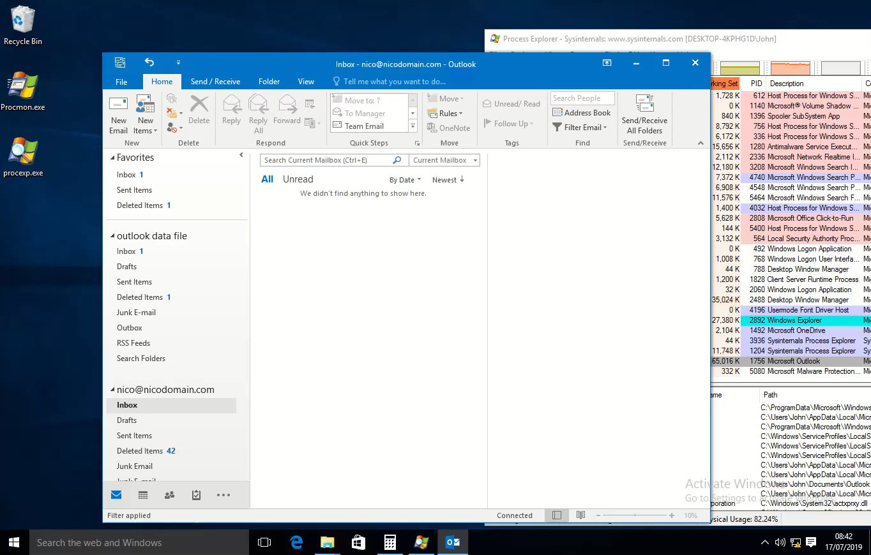
Other class names and bugs related

Slide 24
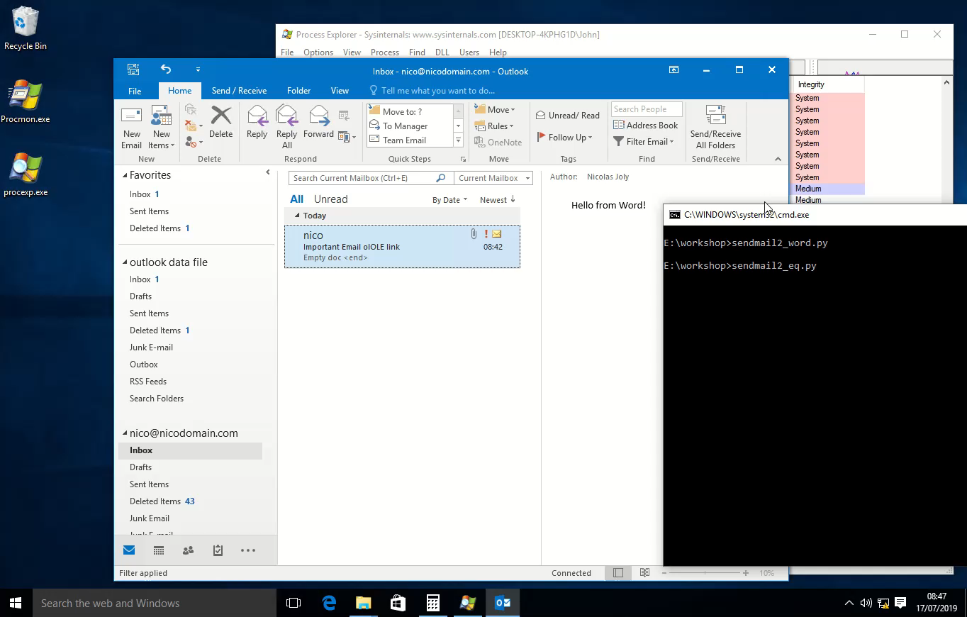
Other class names and bugs related

Slide 25
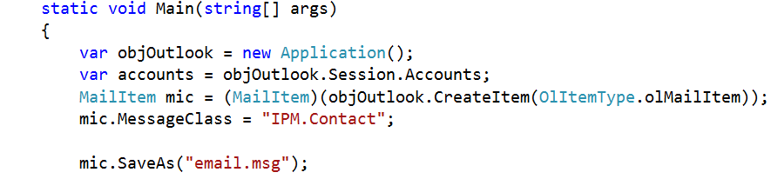
TNEF / .MSG format
Use Interop to create Outlook .msg files

Slide 26
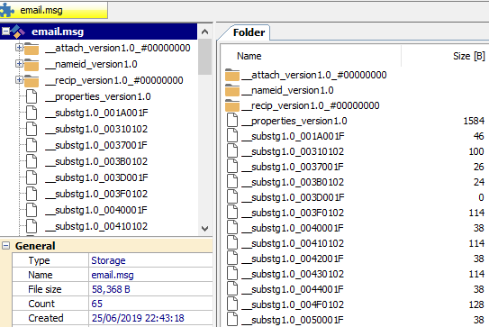
TNEF / .MSG format
Use Interop to create Outlook .msg files

Slide 27
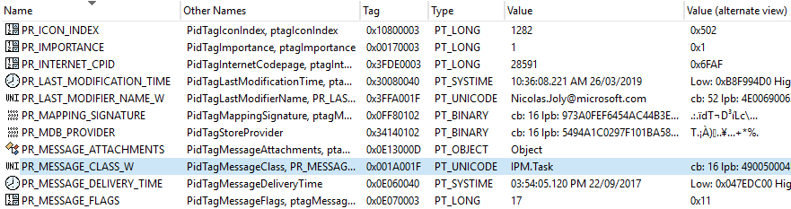
MAPI properties, TNEF and .MSG?
TNEF is “a hierarchy of rich message properties”, a succession of particular attributes, called MAPI properties, forming a stream.
Example below with a Task message:
A MAPI property is defined by a PID, a Type and a value

Slide 28
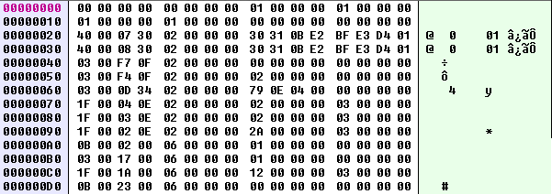
MAPI properties, TNEF and .MSG?
A .MSG is an OLE Storage document, with streams matching MAPI properties, and sub-storages matching MAPI objects
Properties are defined in the __properties_version1.0 stream:
Small properties (integers, bools…) are defined in that stream
Arrays, strings or other objects are defined in their own streams. For example the message class property is defined in __substg1.0_001A001F:

Slide 29

OLE objects in an email, really?
From Haifei’s research, we know that we can embed objects
How are these processed exactly? Can we load scripts?
The OLE storages are easy to manipulate
What else is hiding in there?
Test case, insert an object in an email, put some breakpoints on the usual COM interoperability functions in ole32.dll
ReadClassStg, OpenStorageEx, etc.
Pictures and links are processed differently
With an object link (CLSID_StdOleLink) we can hit OleLoad()

Slide 30
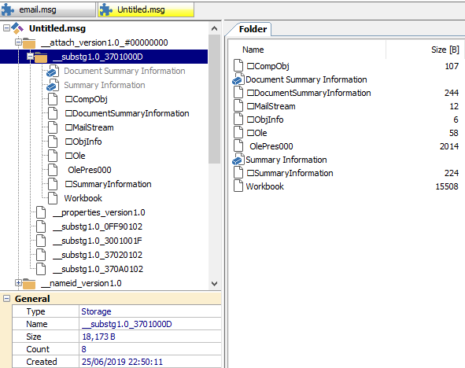
OLE objects in an email, really?
From Haifei’s research, we know that we can embed objects
How are these processed exactly? Can we load scripts?
The OLE storages are easy to manipulate
What else is hiding in there?
Test case, insert an object in an email, put some breakpoints on the usual COM interoperability functions in ole32.dll
ReadClassStg, OpenStorageEx, etc.
Pictures and links are processed differently
With an object link (CLSID_StdOleLink) we can hit OleLoad()

Slide 31
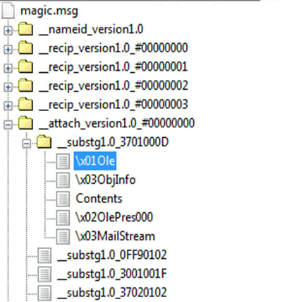

Invoking COM Monikers from a .MSG
Create an RTF email and insert a link (you may want to use an older version of Outlook)
Save it to a .MSG storage
Locate the OLE storage specifically created
Create a new \x01Ole stream underneath
Hit OleLoad()
Instantiate monikers
Profit!

Slide 32

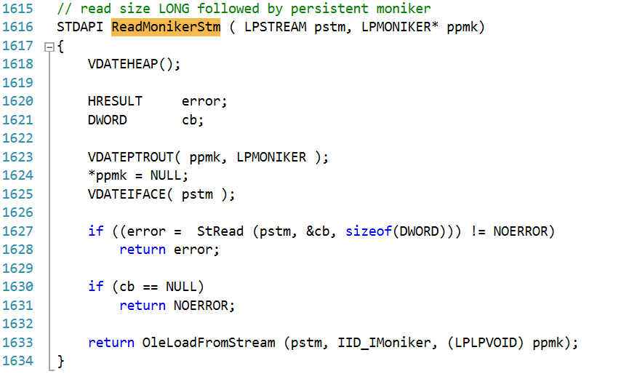
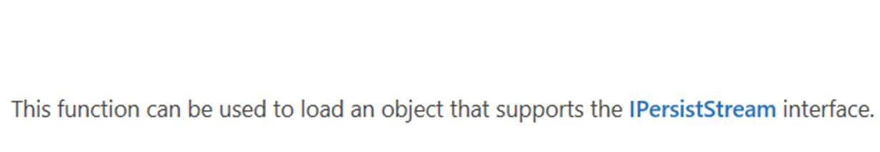
Unmarshalling COM Monikers

Slide 33
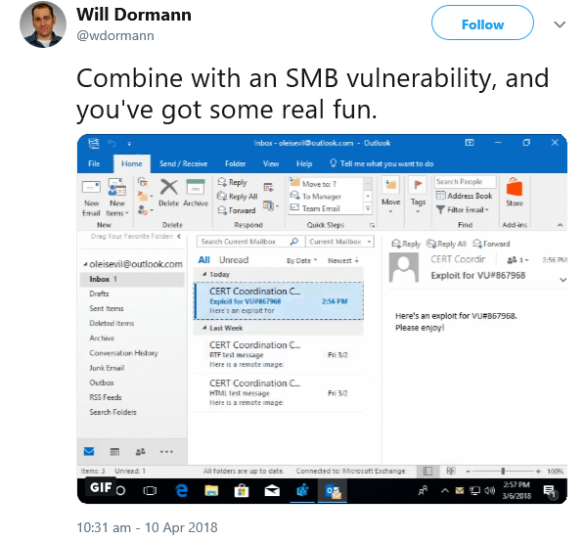
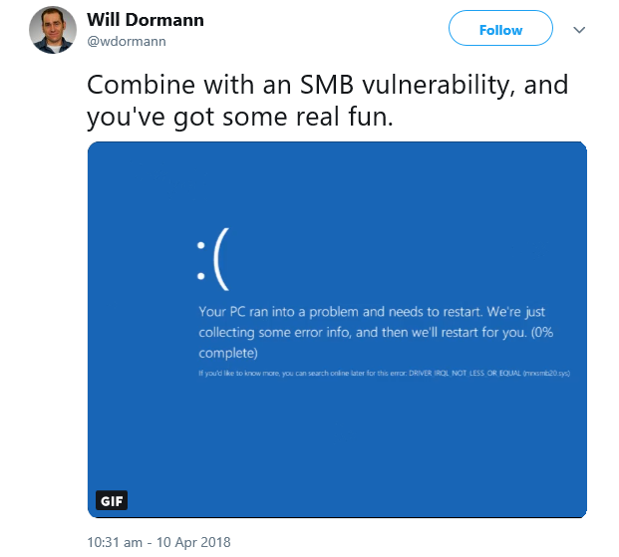
Example: FileMoniker, CVE-2018-0950

Slide 34
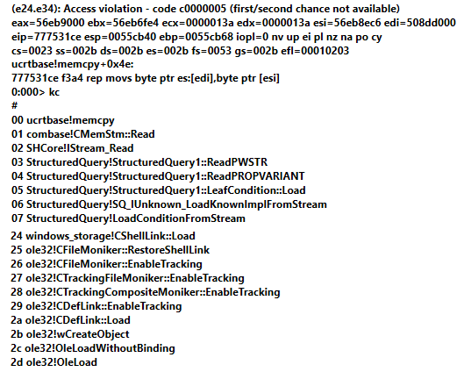
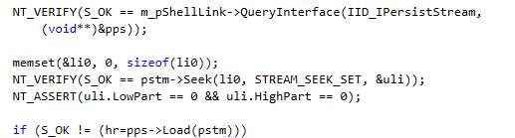
More with the FileMoniker
Ever looked at CFileMoniker::RestoreShellLink in Ole32?
FileMonikers support .LNK shortcuts:
CVE-2018-0825, integer overflow in StructuredQuery
Load dlls with CVE-2017-8464?

Slide 35

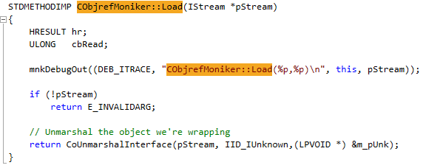

Another example: OBJREF
The objref moniker allows unmarshalling arbitrary objects on the IUnknown interface:

Slide 36
OBJREF – Building the exploit chain
Still far from calc:
IPersistStreamInit::Load
CoUnmarshalInterface
IPersistStreamInit::Load
Calc with a…
Initialize with HTML data

Slide 37
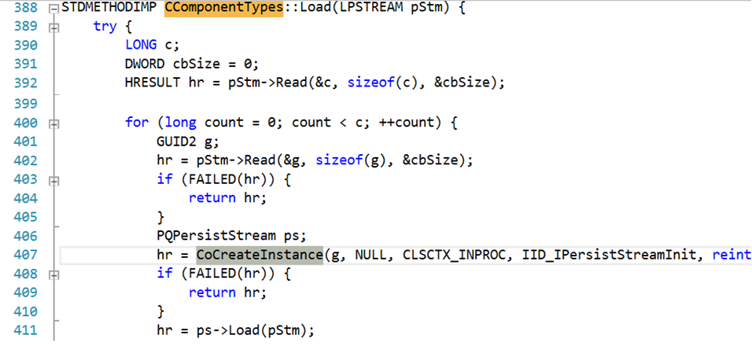
OBJREF – Building the exploit chain
Still far from calc:
IPersistStreamInit::Load
CoUnmarshalInterface
IPersistStreamInit::Load
Calc with a…
Initialize with HTML data

Slide 38

Multiple bugs fixed in this attack
Restrict the objects loaded by msvidctl.dll
CVE-2016-0142, CVE-2016-7248, CVE-2018-0881
Prevent the objref and XML Feed Moniker objects from loading in Office via the COM Activation filter
Do not load OLE objects in the pane
CVE-2018-0950
Fix another VBScript bug
And block VBScript as well in the Activation Filter (recent Office branches only)
Restrict objects loaded by DiagnosticsHub.StandardCollector service
CVE-2018-0824
How is this related at all?

Slide 39

From the preview pane to system
This issue does not only apply to Office, COM marshalling is extensively used by the system
The attack surface is quite large:
VARIANTs
SAFEARRAYs
We just need to find a system COM with a method that accepts such argument

Slide 40
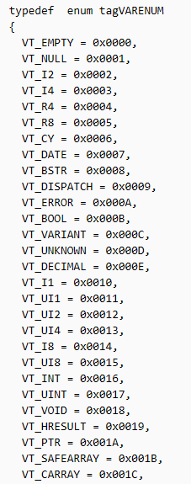
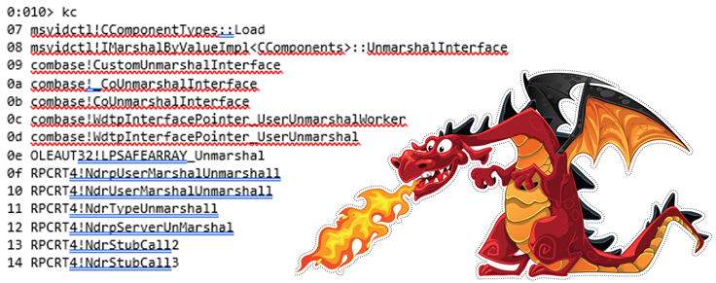
SafeArrays are generic
They can contain bytes, integers, strings, all sorts of objects:
Including VT_UNKNOWN objects
Look at the logic in LPSAFEARRAY_Unmarshal
We can quickly reach another CoUnmarshalInterface
And replay the attack

Slide 41
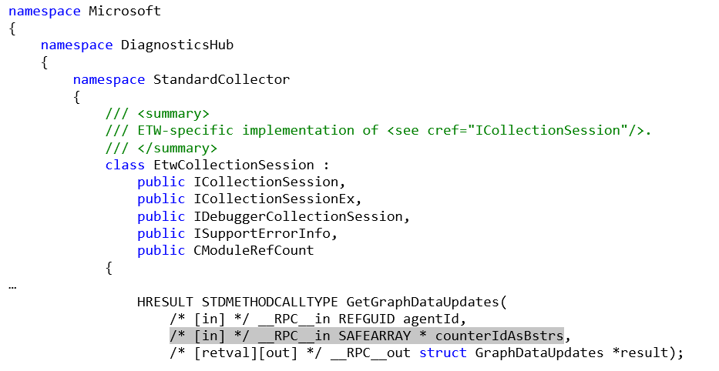
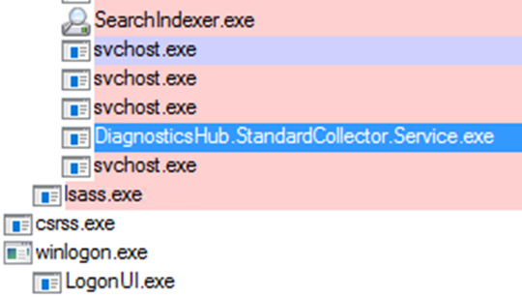
Ex: Diagnostics Hub Standard Collector Service
Just calling GetGraphDataUpdates is enough to trigger the chain

Slide 42
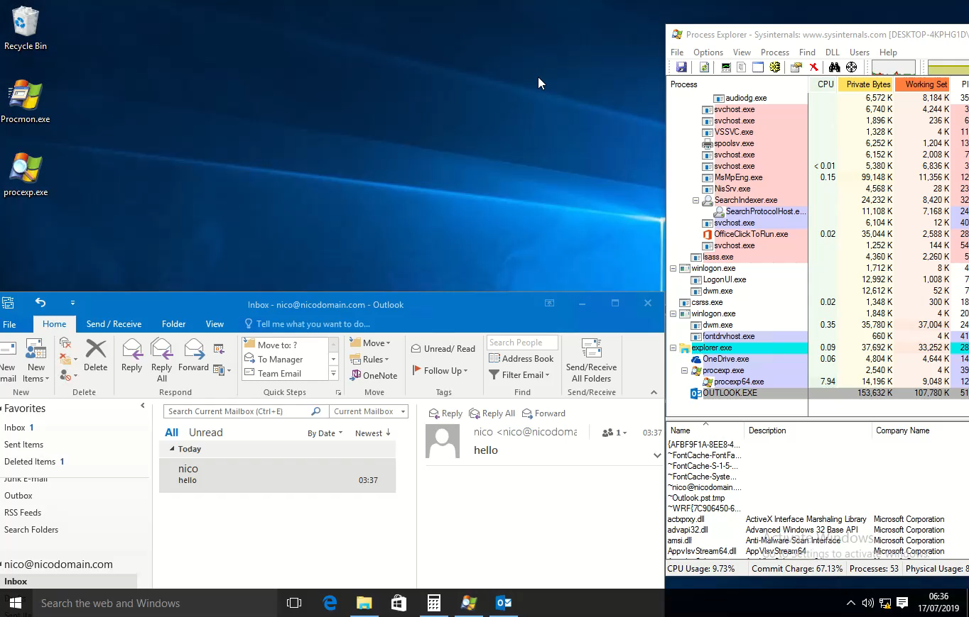
Demo? Quickly?

Slide 43

Attacking Exchange with s

Slide 44
Attacking Exchange with emails
Where to start?
ShadowBrokers’ EnglishmansDentist targeting Exchange 2003
Voicemail Transcription RCE via .NET deserialization (CVE-2018-8302, not an email scenario)
Various attack scenarios:
Are we already authenticated?
Are we playing with memory corruptions? Replaying tokens? Web issues?
Is everything handled by managed code?
Looking at Exchange Onprem gives a good idea of what’s running
exRPC32.dll, what’s that?
Some tools:
MFCMapi

Slide 45
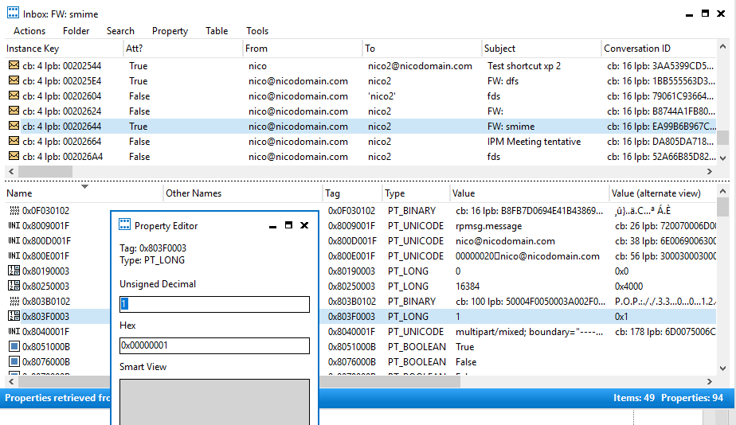
MFCMapi, your best friend

Slide 46
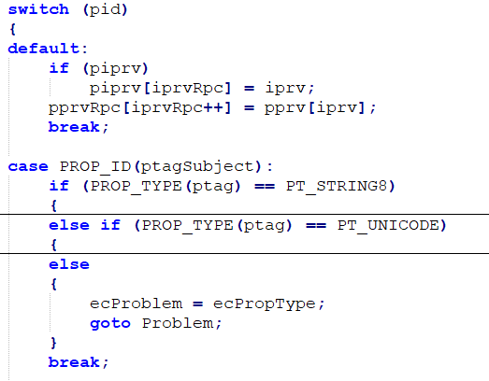
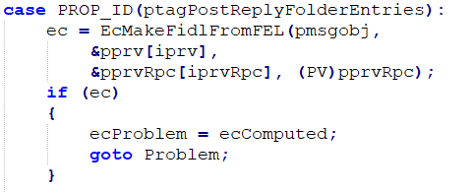
exRPC and MAPI properties
Loaded by MSExchangeDelivery.exe
Several functions parse properties found in TNEF emails:
A property has a pid and a type:
PT_STRING8
PT_INT
PT_BINARY…
Is there any bug left?

Slide 47
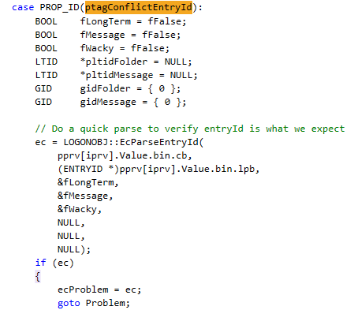
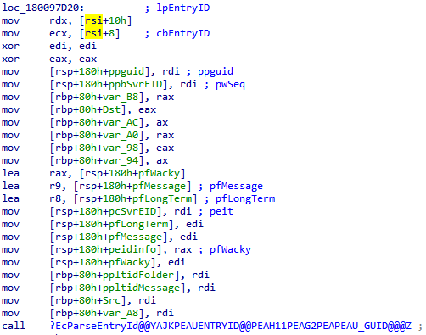
EcParseEntryId
Called for pid ptagConflictEntryId, only accepts a byte array
No checks on the property type
Supported variants are stored on 0x18 bytes on 64-bit
Scalars at offset +8
Pointers at +0x10
Probably a DoS at worst

Slide 48
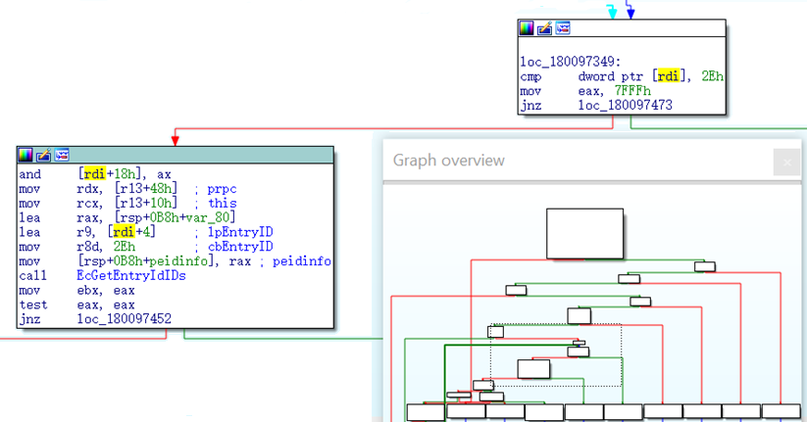

EcMakeFidlFromFEL
Called for pid PostReplyFolderEntries, only accepts a byte array
A loop where data is read and partially written in the original buffer
No bound check
We can alter one bit OOB in the last entry
And [rdi+18h], ax with ax = 7FFFh
So what do you think I did?
Nothing, was too hard ☹

Slide 49
Outcome of that research
Are these issues exploitable? Very unlikely, but proves the concept
Other issues found, essentially type confusions
These are likely exploitable after authentication, DoS otherwise
Found also some issues affecting the .NET binaries
Null pointers leading to temporary DoS
Uninitialized memory while parsing rules
PR_EXTENDED_RULE_ACTIONS
Likely exploitable but would need an infoleak first
Other interesting components to look at, think OWA too
What else can YOU find?

Slide 50
References
https://www.fireeye.com/blog/threat-research/2015/09/attack_exploitingmi.html
https://news.softpedia.com/news/badwinmail-microsoft-outlook-bug-can-give-attackers-control-over-pcs-497795.shtml
https://insights.sei.cmu.edu/cert/2018/04/automatically-stealing-password-hashes-with-microsoft-outlook-and-ole.html
https://cansecwest.com/slides/2016/CSW2016_Li-Xu_BadWinmail_and_EmailSecurityOutlook_final.pdf
https://docs.microsoft.com/en-us/openspecs/windows_protocols/ms-oaut/3fe7db9f-5803-4dc4-9d14-5425d3f5461f
https://docs.microsoft.com/en-us/openspecs/exchange_server_protocols/ms-oxtnef/1f0544d7-30b7-4194-b58f-adc82f3763bb
https://github.com/stephenegriffin/mfcmapi
https://blogs.technet.microsoft.com/srd/2017/07/20/englishmansdentist-exploit-analysis/
https://www.thezdi.com/blog/2018/8/14/voicemail-vandalism-getting-remote-code-execution-on-microsoft-exchange-server
interoplib
CVE-2017-8506, demo on slide3

Slide 51
Thanks all! @n_joly

